Slide 1



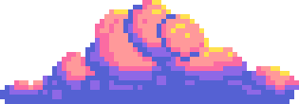



FUN FARM
Hồ Việt Bảo Long - 21125071
Thi Hồng Nhựt - 21125053
Trần Minh Khánh - 21125070
Vương Quang Việt Tùng - 21125145

Slide 2


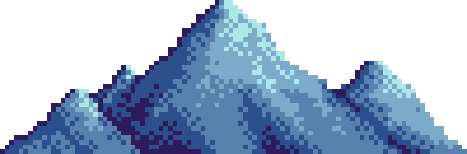
INTRODUCTION
What country is it?

Slide 3


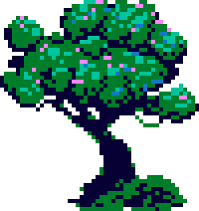

In a village, a farmer was living peacefully with his farm and house. One day, he discovered his land was under siege by hordes of mischievous slimes and relentless skeletons. To protect his home, the farmer armed himself with weapons and decided to fight back against the enemies.
I

Slide 4
2. GAMEPLAY
What country is it?

Slide 5
In this game, players will play as the farmer, who has the following missions:
Grow the plants to collect products
Protect the plants from enemies
Gain money from selling products
Use money to upgrade the items (weapons, plants, lands, etc)
I

Slide 6
I
Enemies of players in this game are skeletons and slimes
They appear after a certain time
They attack and kill our plants

Slide 7



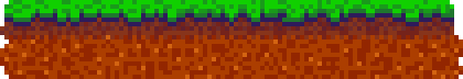
How to Play?
01.
02.
Try to plant as many plants on your field. You can enlarge your plantable land by purchasing more pieces of land.
Take care of your plants. Use your water reasonably because water is not unlimited.
03.
04.
You have to take care of yourself: Buy food in the village or you’ll die.
You have to look out for your enemies: Slimes during the daytime and Skeletons at night.

Slide 8
How to Play?
MovE
WATER
DEFEND
Press Arrow keys
Press W (while there is enough water)
Press D (while there are enough fences)
ATTACK
SWITCH WEAPON
Press Space
Press Tab (if a gun is owned)

Slide 9
3. features
What country is it?

Slide 10
MAIN features
The game has 2 modes: Survival and Creative
Interactive menus: Main menu, Pause Menu, etc.
Control system with keyboard and mouse
Have background music, sound effects
Animations
Minimap
Plant plants, water them before they get deteriorated, and harvest when they are ready.
I

Slide 11
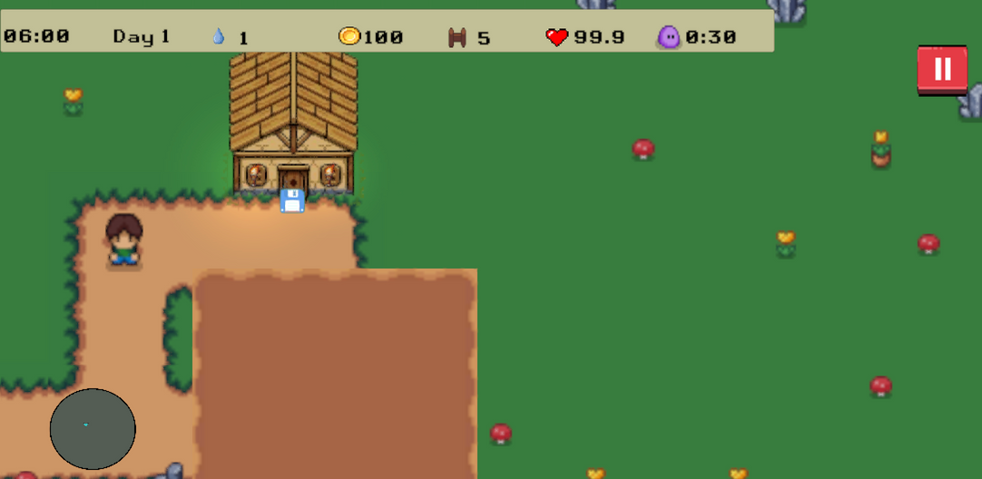
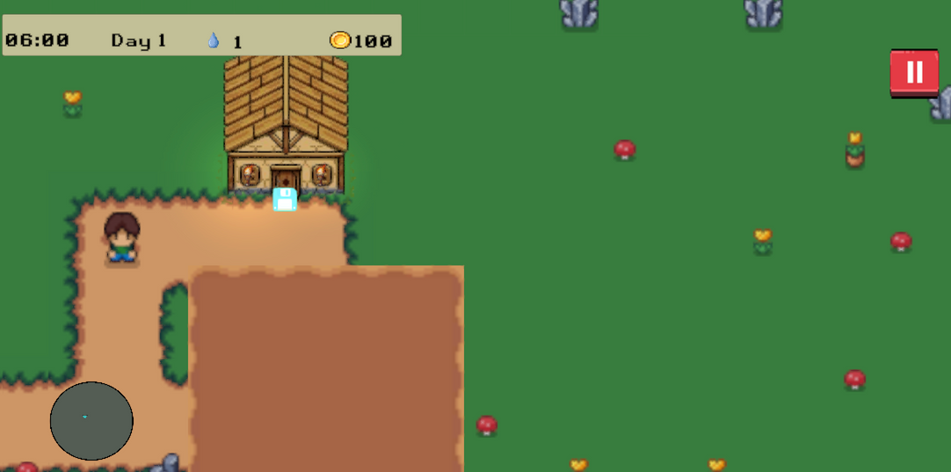
GAME MODES
Survival
Creative
No health
No enemies
No village scene
No defense

Slide 12

PLANTING
I
Planting a tree

Slide 13
PLANTING
There are different types of plants with different deterioration time, leveling up time, purchase price, and harvest price.
The player should water his plants regularly, otherwise, they will get deteriorated.
However, there is a catch: Water is not limited, and the player should allocate water to his plants reasonably. Water is refilled every hour.
I

Slide 14
TUTORIAL SCENE
I

Slide 15
TUTORIAL SCENE
I
The game saves whether the player has opened the game before.
If no, a tutorial scene will be shown to introduce the player with basic gameplay.

Slide 16
SERIALIZATION
I

Slide 17
SERIALIZATION
I
The game supports saving and loading. Since the game is quite time-consuming, it is necessary for a user to save and load it again when needed.

Slide 18
PLAYER ATTACK - SWORD
I

Slide 19
PLAYER ATTACK - GUN
I

Slide 20
PLAYER ATTACK - GUN
I
Using a gun inflicts more damage to enemies and it is also a feasible way to attack within a long range.

Slide 21
BUILDING FENCEs
I

Slide 22
BUILDING FENCES
I
Fences are used to prevent enemies from advancing further. Every day, there are 10 fences for a player to place on his land.

Slide 23
BUYING NEW PIECES OF LAND
I

Slide 24
BUYING NEW PIECES OF LAND
I
To be able to plant more, it is possible to purchase new pieces of land in the game.

Slide 25
BUYING FOOD
I

Slide 26
BUYING FOOD
I
The player gets more and more fatigued throughout the day. When his health reaches 0, he dies. Therefore, food must be provided to recover his health. To buy food, he goes to the village (during the day only) and reaches the market.

Slide 27
skeleton’S aI
I

Slide 28
SKELETON’S AI
I
At night, skeletons appear and attempt to kill the player. They chase the player and move to wherever the player is, even when he is moving. One skeleton is going to sabotage both torches to turn the lights off to make the atmosphere darker.

Slide 29
ENEMIES
I
Slimes: Generated during daytime and they destroy plants, but only when there is at least one planted plant.
Skeletons: A couple is generated at night and they try to kill the player. A couple of skeletons is only generated when there are no other skeletons on the scene.

Slide 30
WEATHER
I
The weather in the game can be randomly rainy or sunny.
When rainy, these things happen:
Deterioration progresses of plants are delayed
Walking speed is reduced
The sky is slightly darker

Slide 31
WEATHER
I

Slide 32
4. graphIc assets
What country is it?

Slide 33
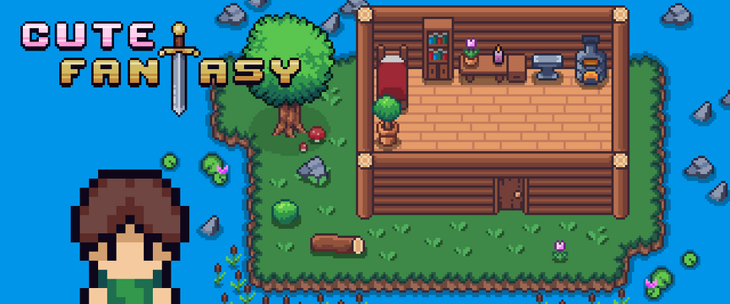
All assets are taken from free assets on itch.io
Main asset pack: Cute Fantasy Free (with limited player animations, plants, and weapons)

Slide 34




These assets are taken from https://github.com/msikma/pokesprite
Main asset pack: Berry

Slide 35
5. ImplementatIon
What country is it?

Slide 36
Player moVING
When idling, the Animator component of the player game object plays the Idle animation according to its current orientation. There are 4 possible orientations: UP, DOWN, LEFT, RIGHT. If the pressed (or held) key is different from the current orientation, a function for switching has to run first before the player starts moving (if the key is being held).
The game also detects when holding a key (instead of just pressing), the player will start moving.

Slide 37
PLANT MANAGER
I
Planted plants are stored in a dictionary with keys being Vector3Int, indicating positions of plants on the Plant tilemap.
The next deteriorating time and the next leveling up time are stored and they’re checked in the FixedUpdate to ensure the plants level up or get deteriorated accordingly.

Slide 38
PLANT MANAGER
I
When the player waters a plant, the Time value for The next deteriorating time is added, making the deterioration slower.

Slide 39
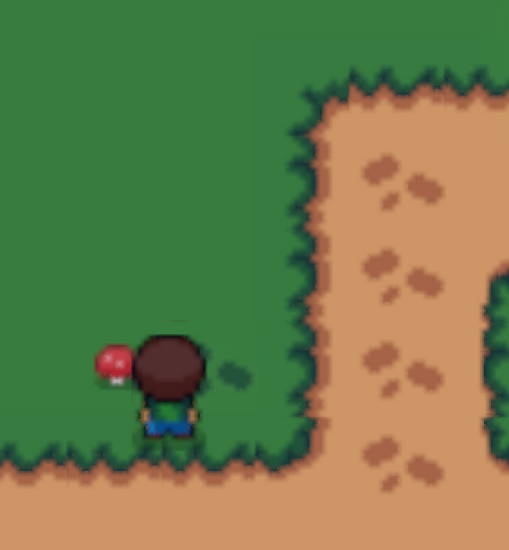
FOOTPRINT
Every tile is associated with a footprint tile.
The game saves the current position to lastPosition when the player arrives at that position. When the player moves (lastPosition != currentPosition), a new object storing footprint information (position, time) is pushed to a queue.
I

Slide 40
FOOTPRINT
A footprint disappears after 10 seconds. In FixedUpdate, the game tries to dequeue and make the footprint disappear as far as possible, meaning that when the current top item of the queue does not meet that requirement to disappear, it can stop dequeuing (because for a FIFO queue data structure, if the current top item has not been there long enough, later items are also certain to not meet this requirement).
I

Slide 41
HEALTH
Health is stored in a class called Unit. For the player, apart from health, there is information on water amount and money. This is stored in an inherited class called PlayerUnit.
Unit
PlayerUnit

Slide 42
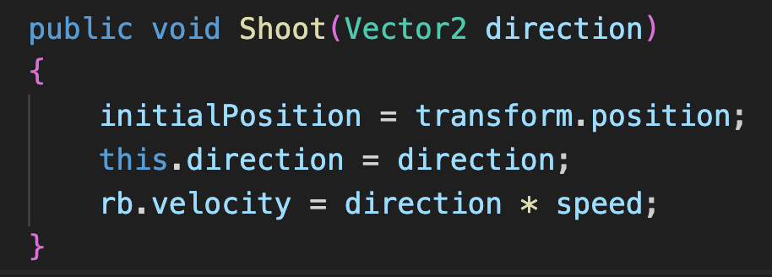
SHOOTING
Bullets from the player’s gun use Kinematic rigidbody to make it movable by only applying a velocity to the rigidbody itself. This behavior is intended.

Slide 43
SHOOTING
When OnTriggerEnter2D runs (the collider of a bullet triggers) and hits anything with the Enemies tag (Skeletons and Slimes), it makes the SpriteRenderer component of the hit object turns red using Color.Lerp to make it turn red for an amount of time.

Slide 44
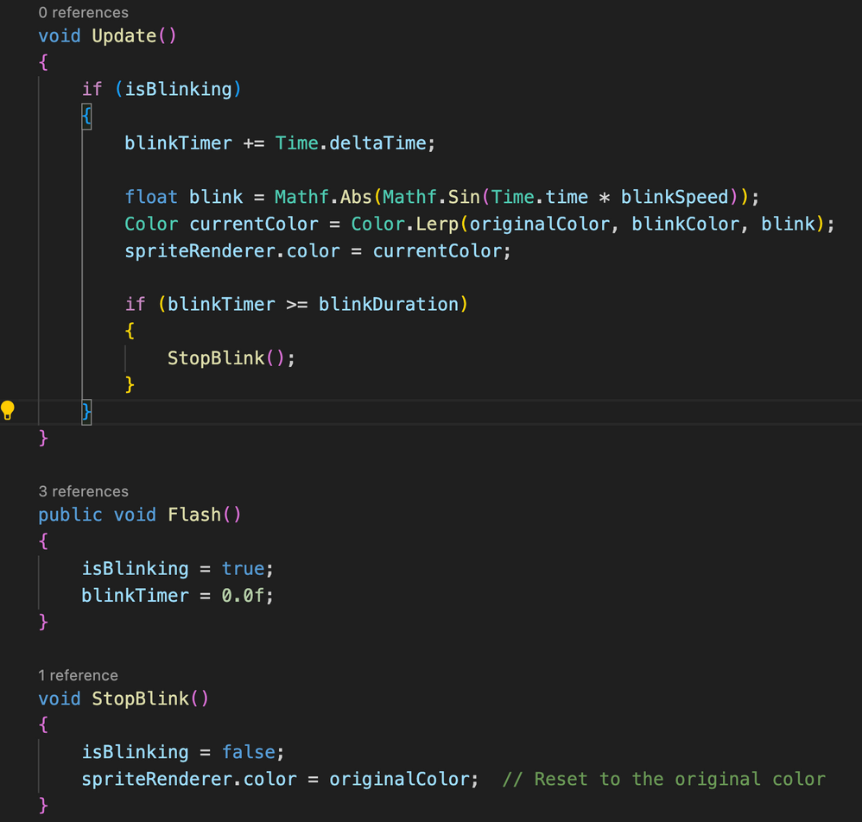
SHOOTING

Slide 45
SCRIPTABLE OBJECT
I
Scriptable Object (SO) is a way to store data across different game objects and game scenes. This is helpful to store stats without the need of a game object. Another helpful use is initializing basic information of an object in the game.

Slide 46
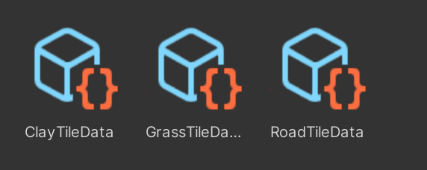
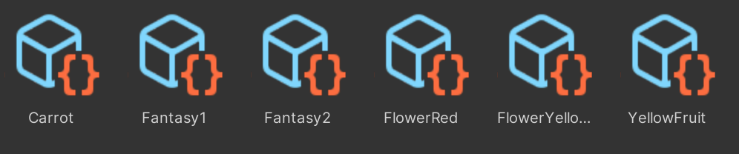
SCRIPTABLE OBJECT
I
In this game, SOs are used to store information of:
Terrain tiles
Plants

Slide 47
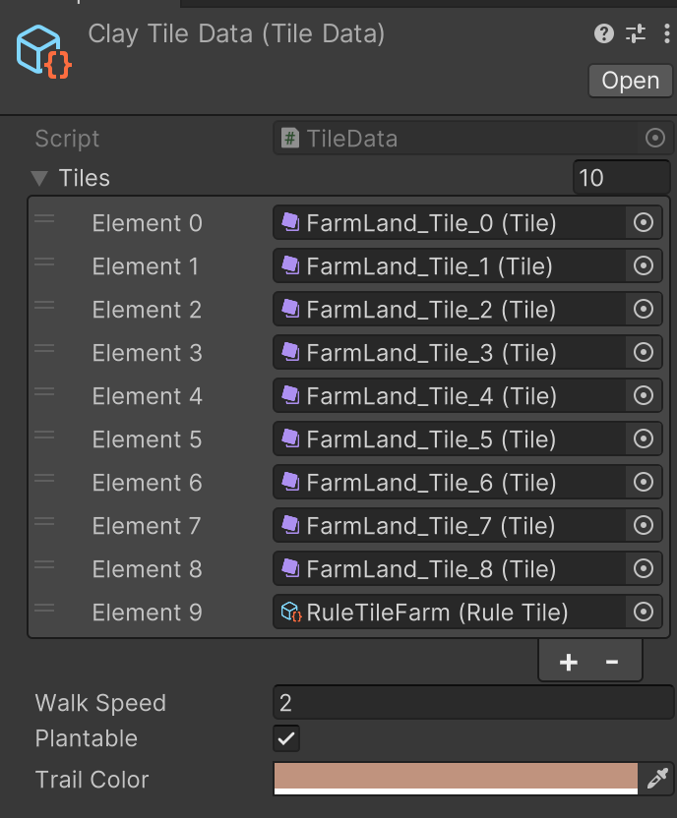
SCRIPTABLE OBJECT
SO is used to store basic information about a specific tile, including walking speed, plantable, and trail color (all are going to be mentioned later).

Slide 48
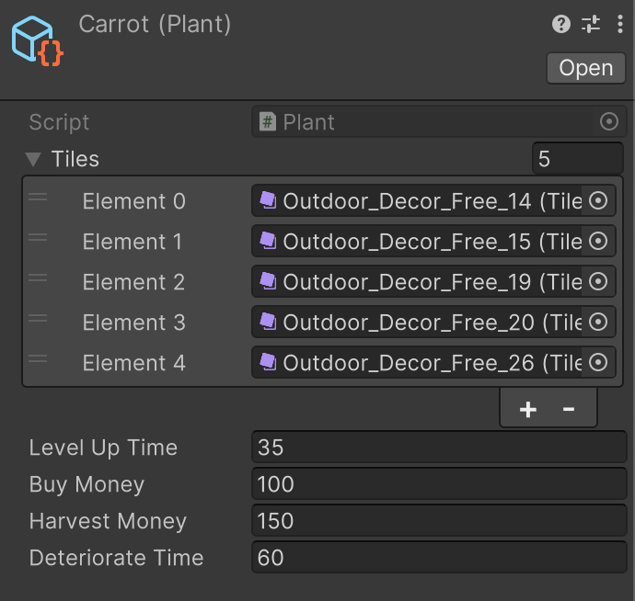
SCRIPTABLE OBJECT
SO for plants

Slide 49
WALKING SPEED BY TERRAIN
This field is used to manipulate walking speed according to different tiles.

Slide 50
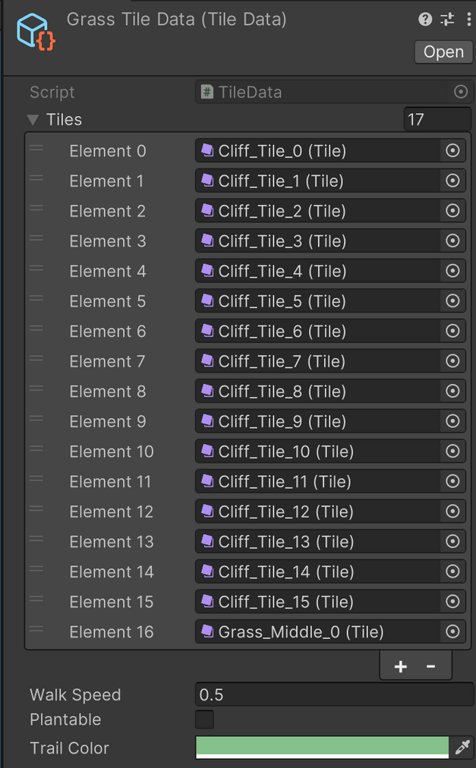
WALKING SPEED BY TERRAIN

Slide 51
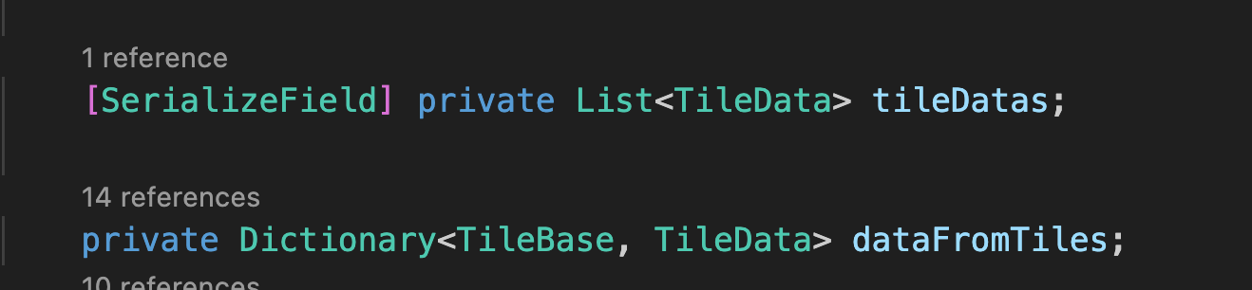
WALKING SPEED BY TERRAIN
Tiles of a SO are then reassigned as keys to a dictionary, with their values being their respective SOs.

Slide 52
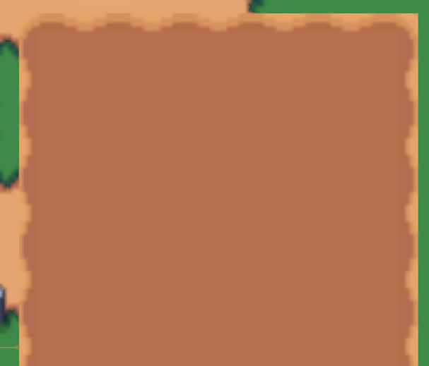
RULE TILE
The game consists of a feature called Land Purchase. It is noticeable that the land has a layout to make it look realistic.
For edge tiles, there should be a curve acting as an edge instead of filling a totally brown edge.

Slide 53
RULE TILE
Therefore, Rule Tile is applied to ensure that edge tiles must have these “edge” curves.

Slide 54
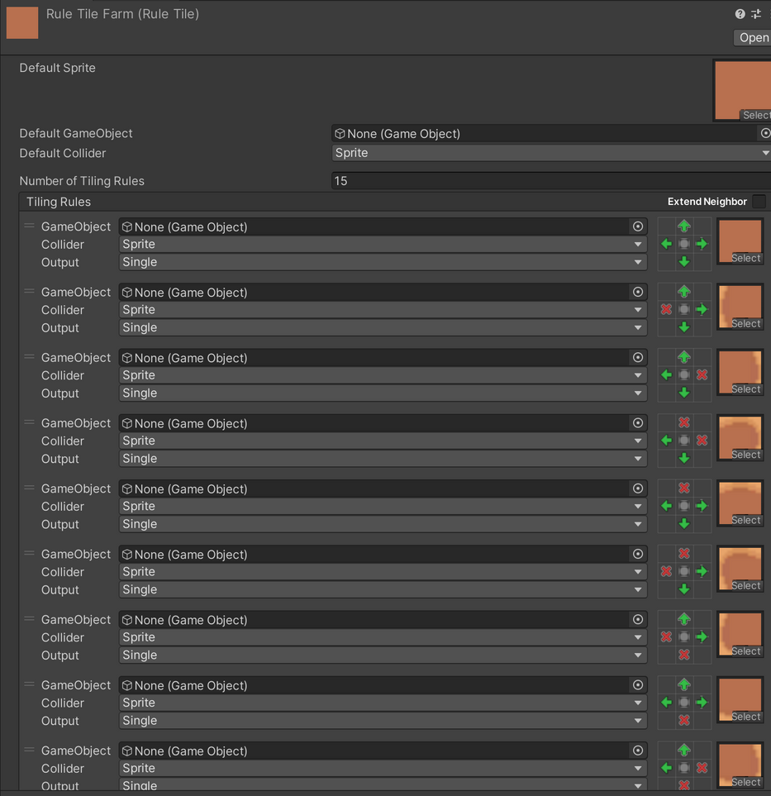
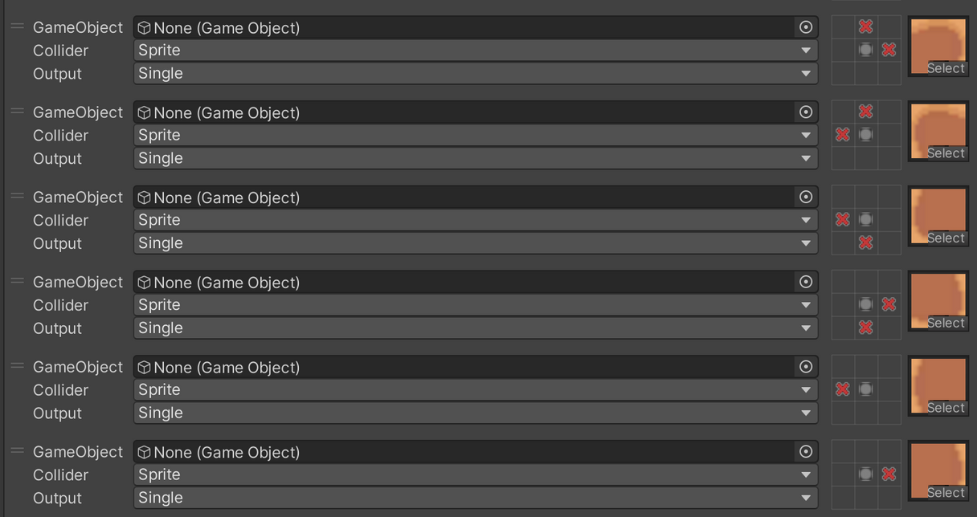
RULE TILE

Slide 55
RULE TILE
Complete tile when all are surrounded
Border on the left when the left side is unoccupied
Border on the right when the right side is unoccupied
Border on the top right when the right side and top side are unoccupied
Border at the top when the top side is unoccupied
Border on the top left when the left side and top side are unoccupied
Border on the bottom left when the left side and bottom side are unoccupied
Border an the bottom when the bottom side is unoccupied
Border on the bottom right when the right side and bottom side are unoccupied

Slide 56
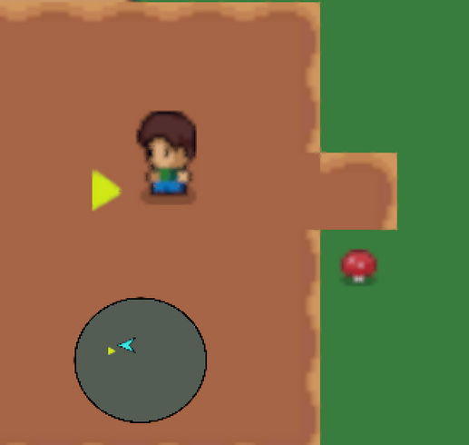
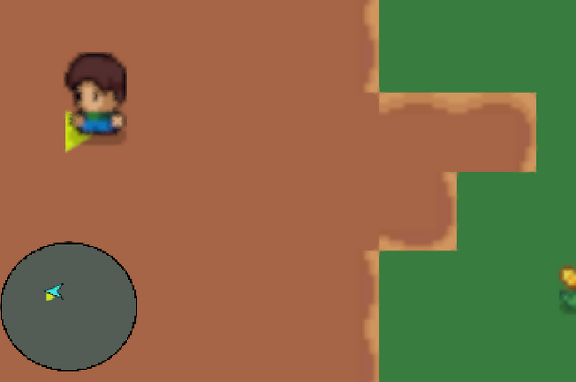
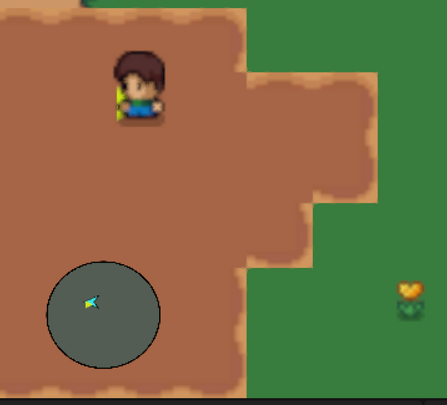
RULE TILE

Slide 57
OBJECT POOLING
Object pooling is a design pattern that can provide performance optimization by reducing the processing power required of the CPU to run repetitive create and destroy calls. Instead, with object pooling, existing GameObjects can be reused over and over.
This is useful when there is a GameObject that has to be instantiated repeatedly in the game.

Slide 58
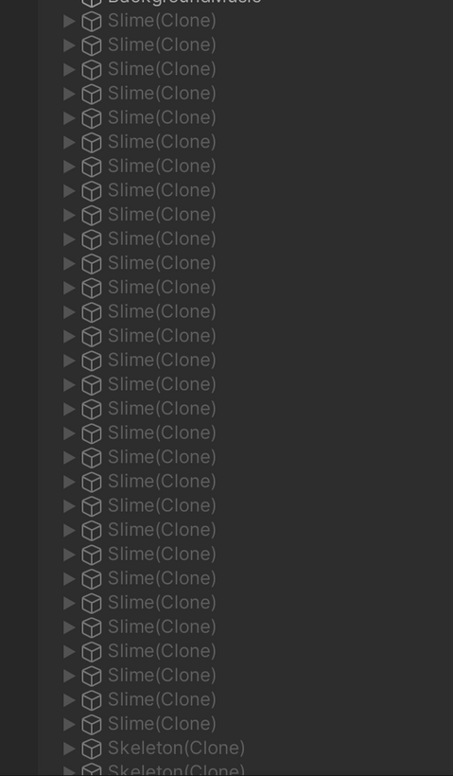
OBJECT POOLING
Slimes and Skeletons when they are not ready to spawn

Slide 59

OBJECT POOLING
When slimes are ready to spawn

Slide 60
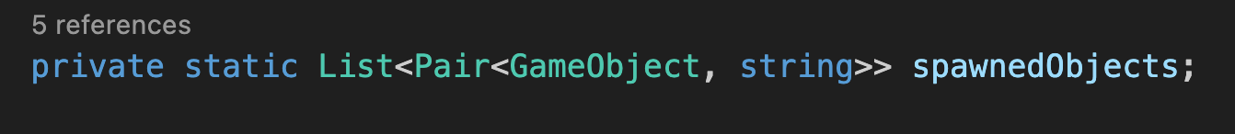
OBJECT POOLING
Store different queues for different GameObjects.
Keep track of spawned objects to put them back when they are no longer in use.

Slide 61
OBJECT POOLING
Object pooling is also used for spawning bullets since bullets can be instantiated many times throughout the game.

Slide 62
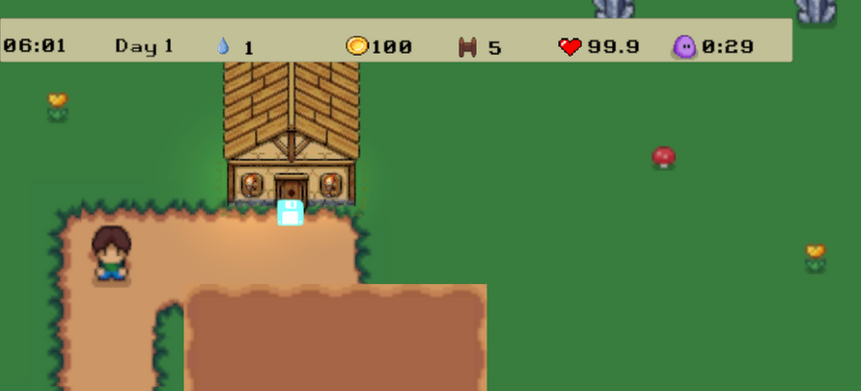
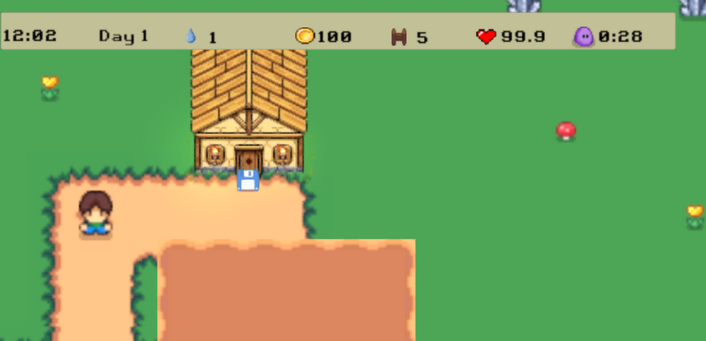
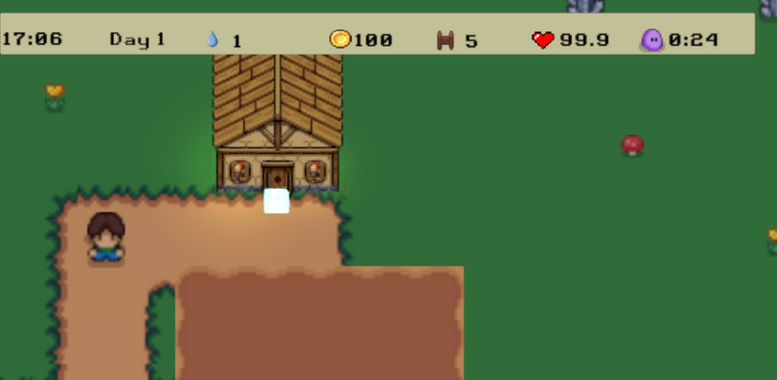
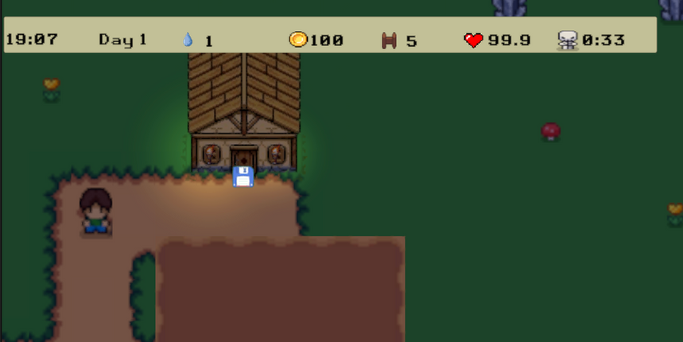
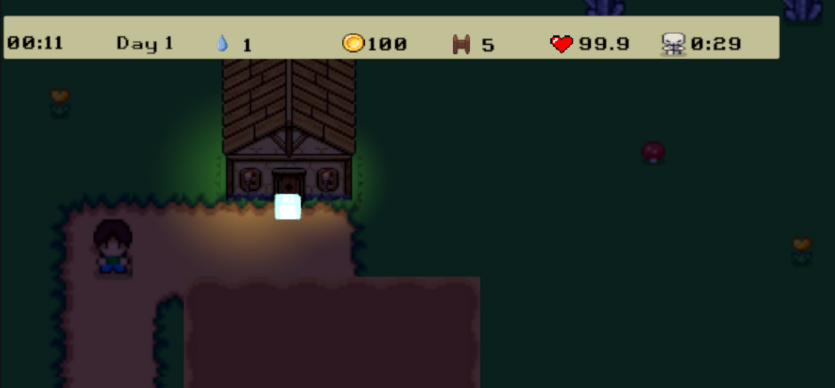
DAY/NIGHT CYCLE
To simulate day-night cycle in the game, we used Global Light 2D with a color that changes throughout the day.

Slide 63


DAY/NIGHT CYCLE
The intensity of the Global Light also fluctuates throughout the day to match with the time.
This can be achieved by using Mathf.Lerp
Light intensity: 0.8 - 1.5
Light intensity: 0.1 - 0.65

Slide 64
DAY/NIGHT CYCLE
Another Spot Light 2D is used to simulate light emitted from a torch.

Slide 65
SHADER
Using shader is a good way to manipulate graphical aspect of a sprite in the game.
In our game, we’ve implemented shader to create effect on:
The Save icon
Plants when they’re ready to be harvested

Slide 66
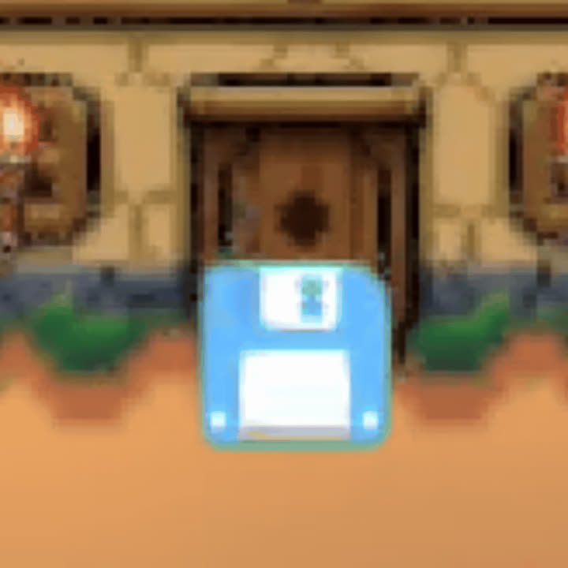
SHADER

Slide 67
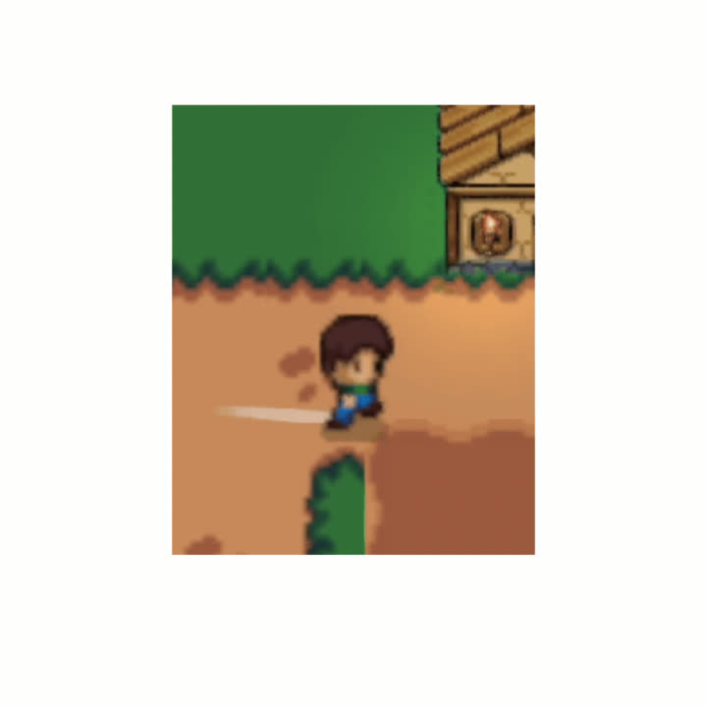
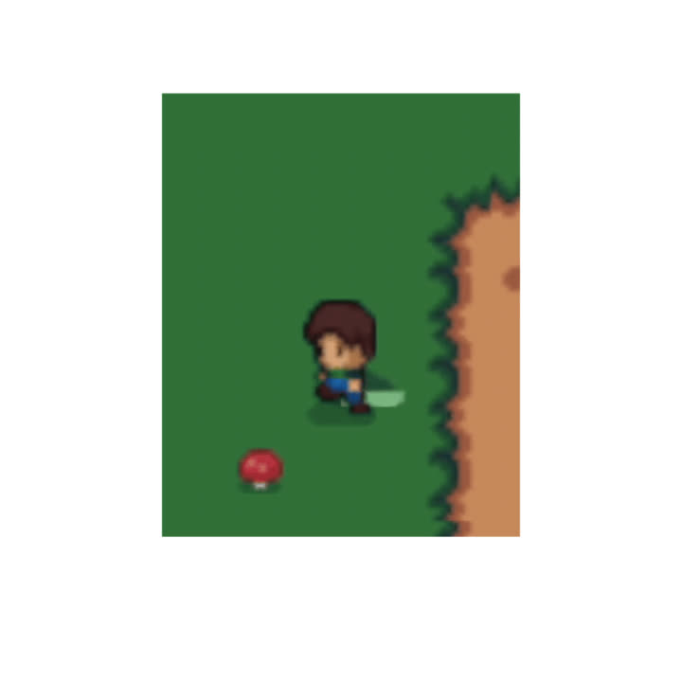
PARTICLE SYSTEM
Particle system is used to implement the dust trail effect when the player moves on dirt or grass in the game.

Slide 68
PARTICLE SYSTEM
The dust trail color is saved in tiles’ respective Scriptable Objects. By applying this color to the start color of the dust trail particle system, we were able to make the trail look similar to the terrain.

Slide 69
MINIMAP
I
To implement a minimap that allows the player to easily navigate incoming enemies, we have added the following objects to our game:
Layers
Indicating arrows
Another camera

Slide 70
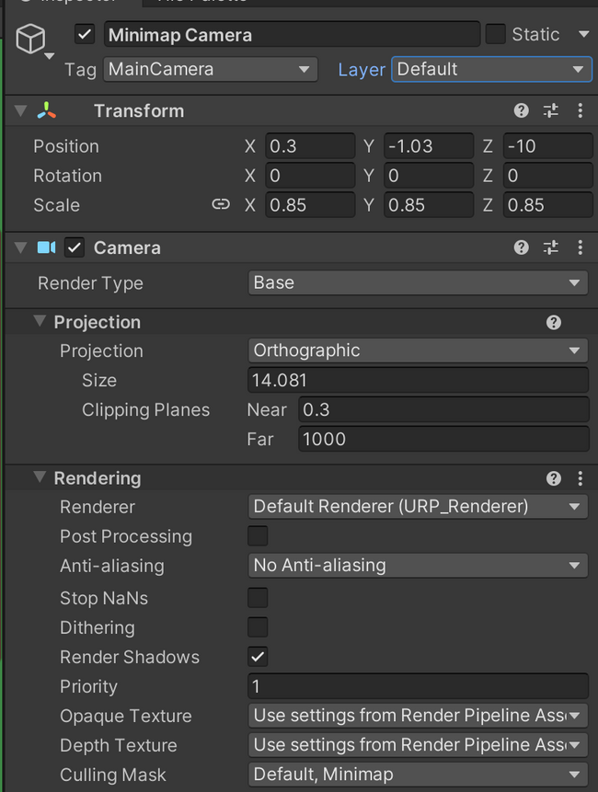
MINIMAP
We added a new layer: Minimap. This layer contains indicating arrows only since the minimap only shows these arrows and it does not show other things, such as plants.
Next, we created a secondary Camera in our game scene. This camera only shows objects from the Minimap layer.
I

Slide 71
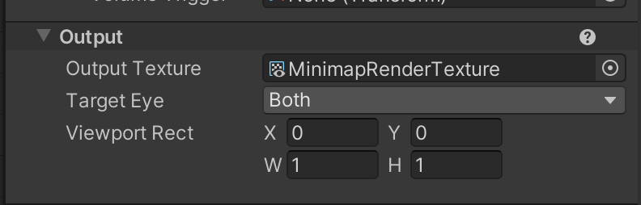
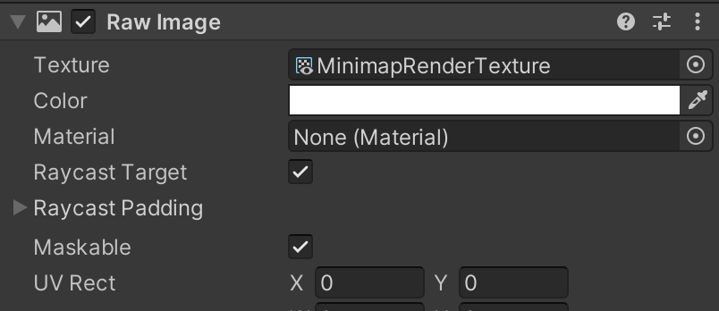
MINIMAP
Next, we created a new Render Texture and set the output texture of the minimap camera to this render texture. To show the map on the screen, we added a new Raw Image component and set its texture to the aforementioned render texture.
I

Slide 72
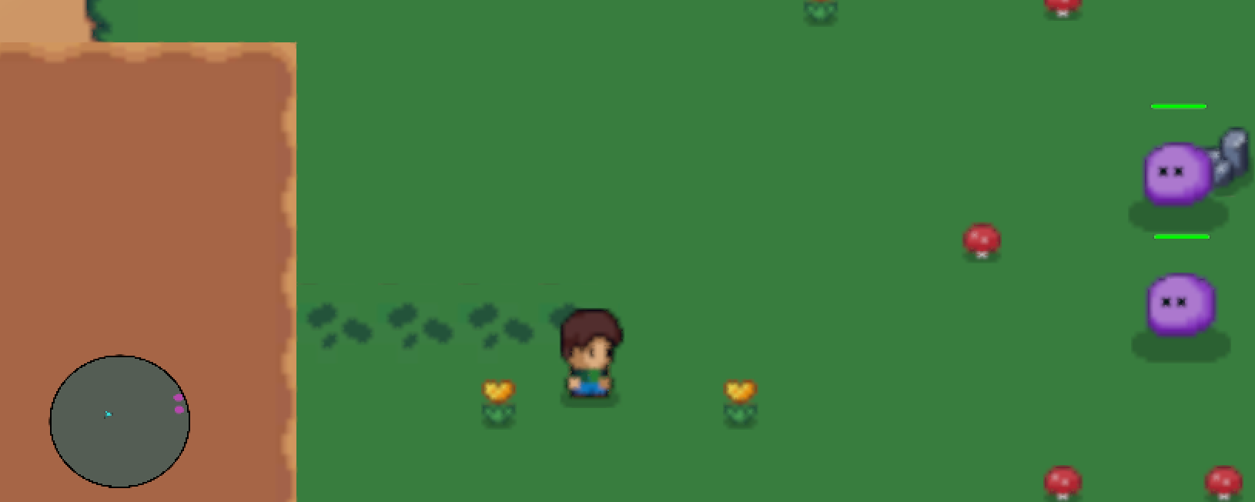
MINIMAP
I

Slide 73
SERIALIZATION
I
To save and load game, we constructed classes that are intended for serialization and only contain neccessary and serializable information.

Slide 74
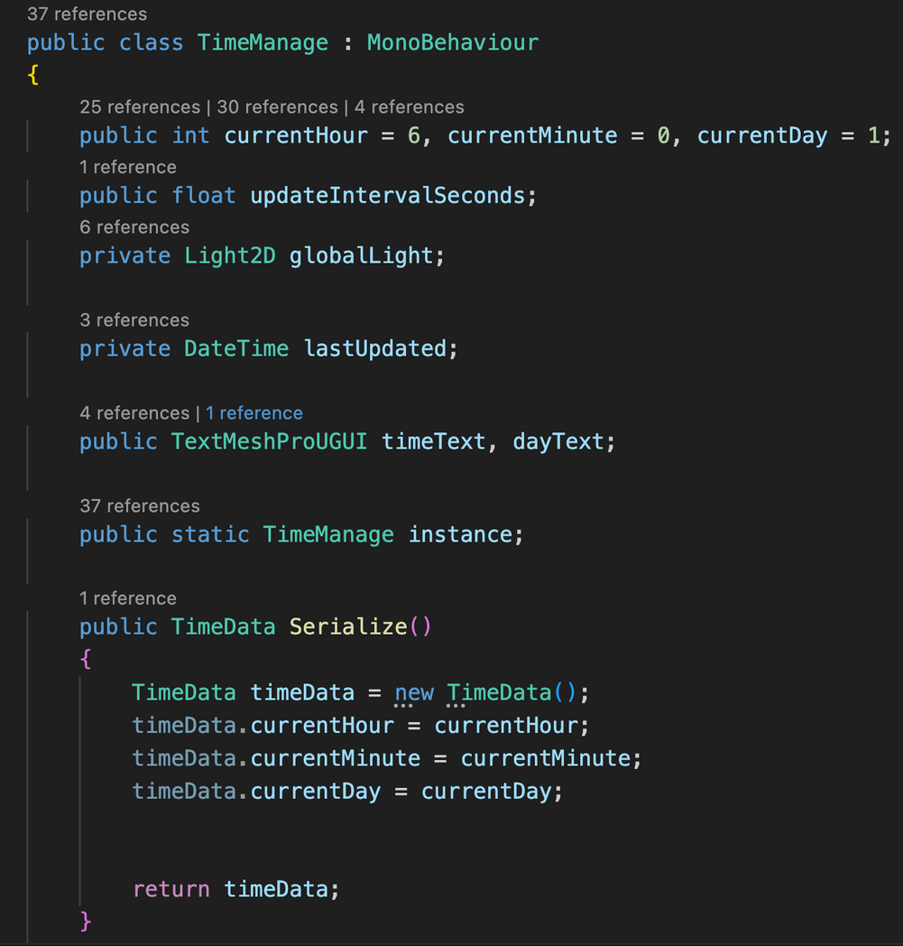
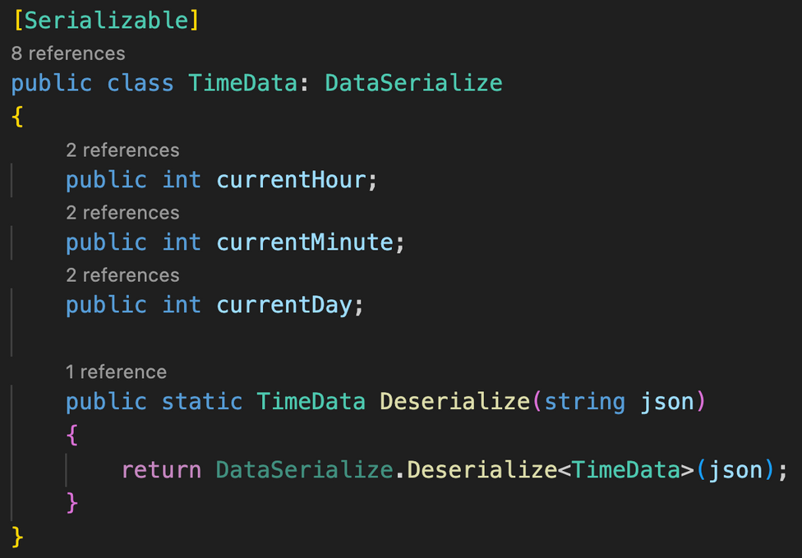
SERIALIZATION
I

Slide 75
SERIALIZATION
I
Objects of the Dictionary class are not serializable. A workaround is to create an alias class

Slide 76
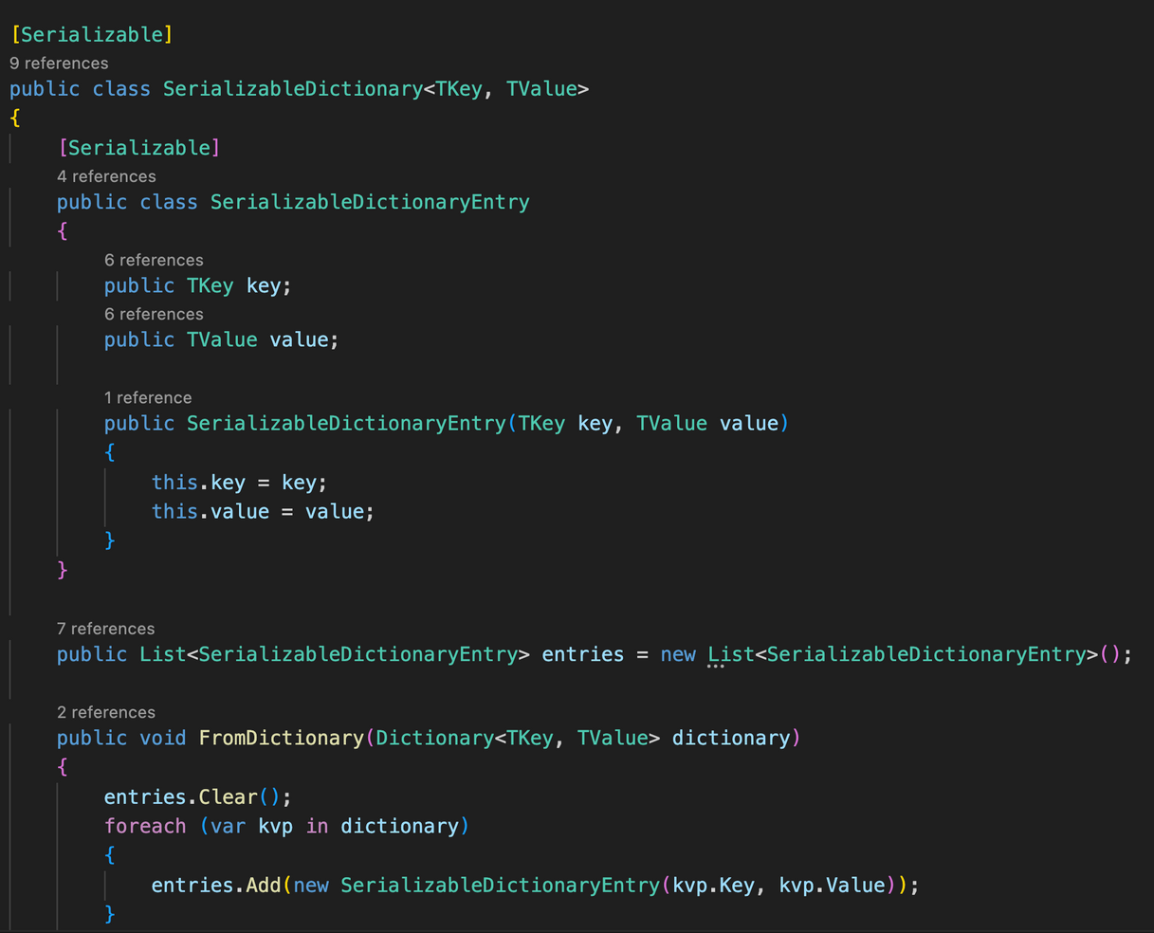
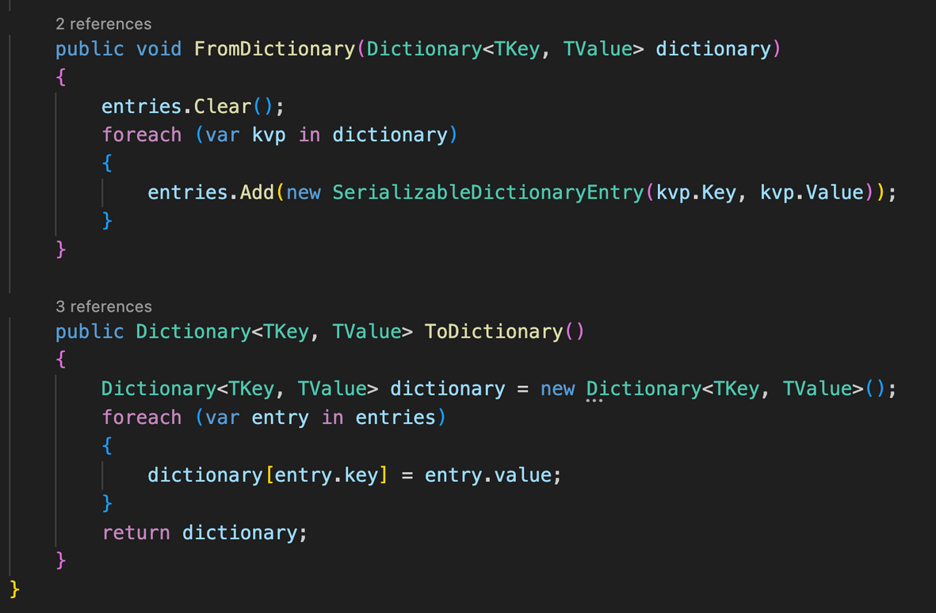
SERIALIZATION
I

Slide 77
RAIN
I
The raining effect is created by using the Particle System. We call this object Rain.
To make the splash effect, we’ve enable the Collision feature (World) of the Particle System (with Bounce = 0 and Lifetime Loss = 0.1).

Slide 78
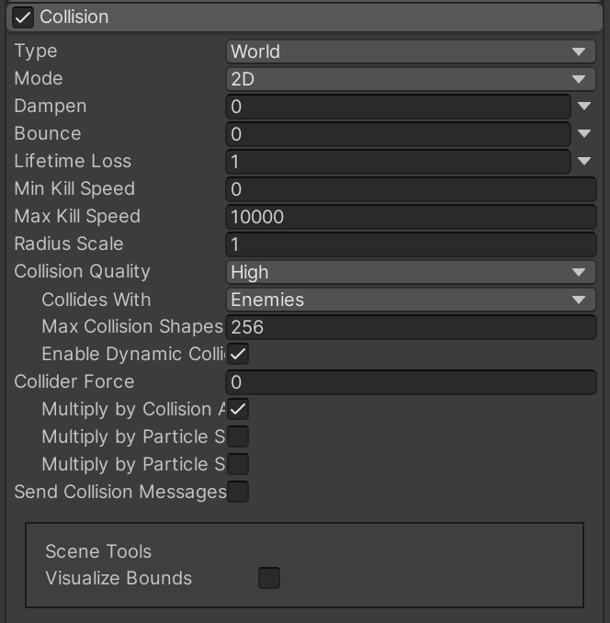
RAIN
I

Slide 79
RAIN
I
To make the rain looks more realistic, a splash effect on the ground is also implemented. This is also implemented using the Particle System.
The new particle system object is set as the sub-emitter of the aforementioned Rain particle system.

Slide 80
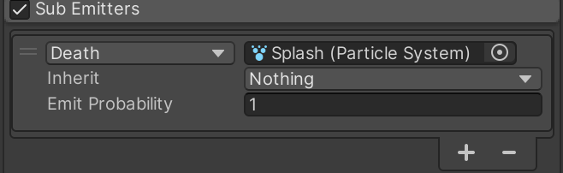
RAIN
When raindrops hit, they die. After this, splashes are shown.

Slide 81
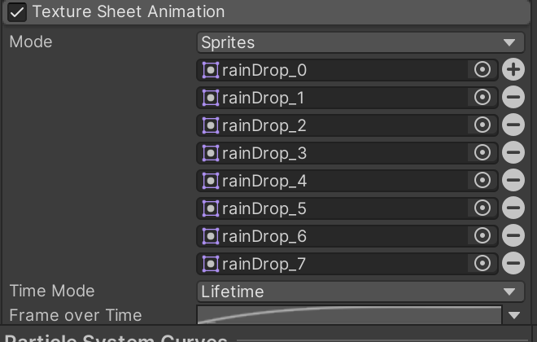
RAIN
I
The Splash particle system use the Texture Sheet Animation component to make it look like a raindrop splashing after hitting.

Slide 82
RAIN
I

Slide 83
GAME DEMO
01.
02.
Try to plant as many plants on your field. You can enlarge your plantable land by purchasing more pieces of land.
04.

Slide 84
01.
02.
THE END.
Try to plant as many plants on your field. You can enlarge your plantable land by purchasing more pieces of land.
04.

